Slide 1



schedule dashboard
View in Power BI
Last data refresh:
7/5/2025 9:17:22 PM UTC
Downloaded at:
7/5/2025 9:31:06 PM UTC

Slide 2
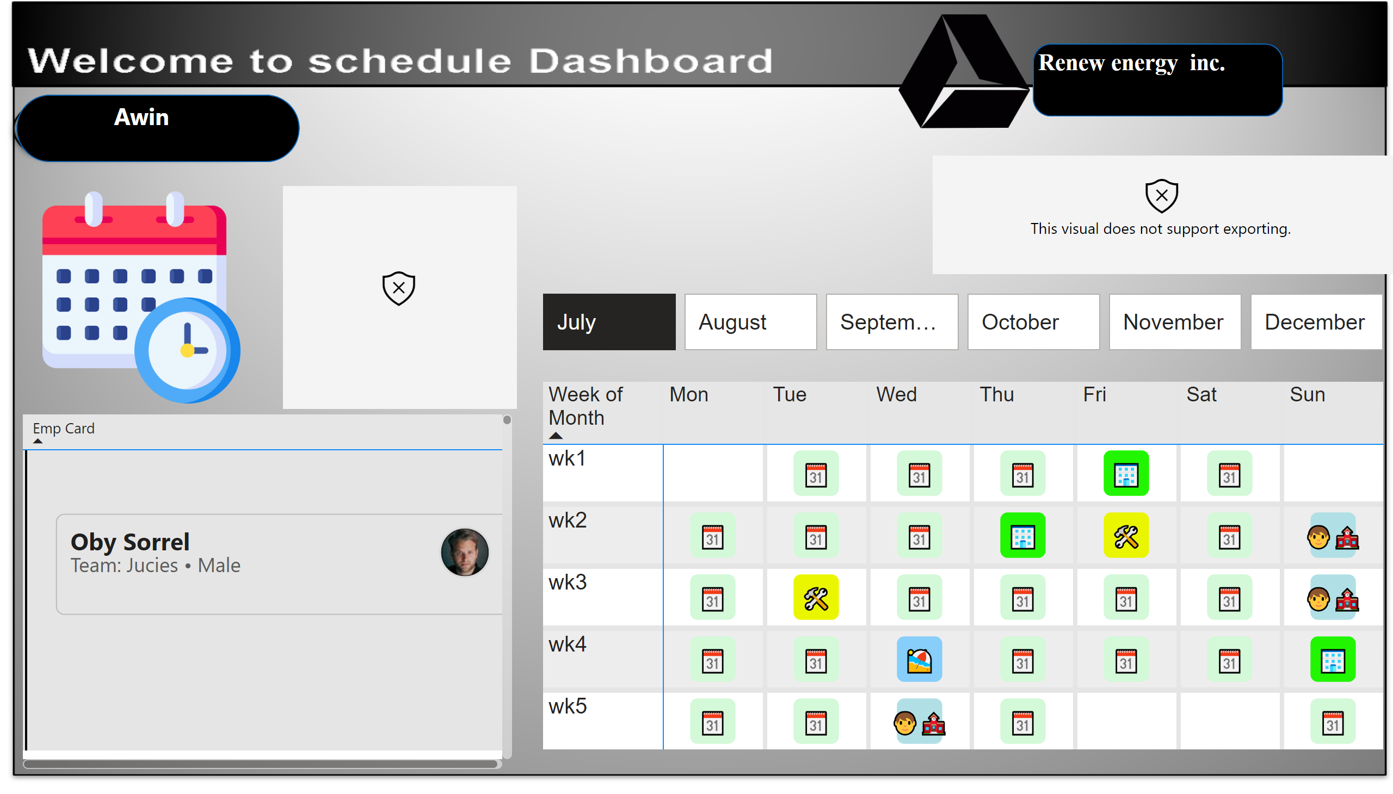
Page 1
Notes:
htmlContent443BE3AD55E043BF878BED274D3A6855
No alt text provided
tableEx
No alt text provided
pivotTable
No alt text provided
advancedSlicerVisual
No alt text provided
htmlContent443BE3AD55E043BF878BED274D3A6855
No alt text provided
image
No alt text provided
image
No alt text provided
shape
No alt text provided
textbox
No alt text provided
shape
No alt text provided
textbox
No alt text provided

